Slide 1
Kasatria Entrance Test Data Analyst Nguyen Thu Huong

Slide 2
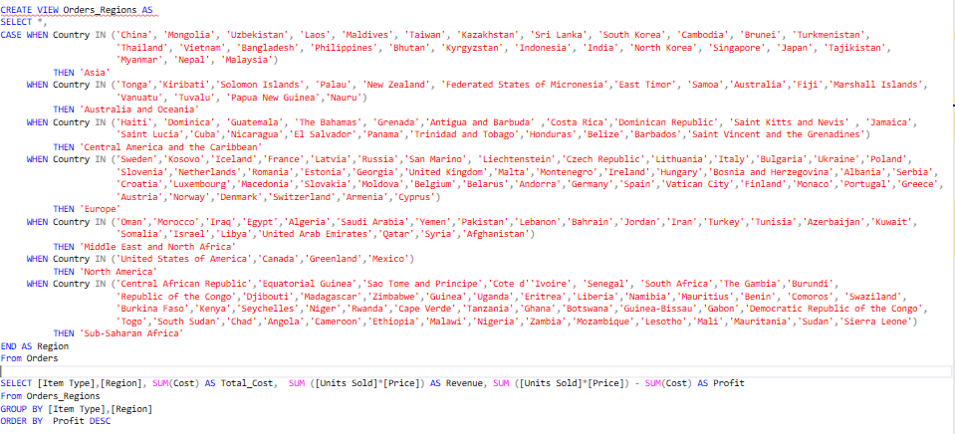
Total cost, revenue and profit by both region and item type?
Using SSQL to create a temp table and use aggregate functions to calculate Total cost, Revenue and Profit:

Slide 3
Total cost, revenue and profit by both region and item type?
We can get the result with the highest profit as table below:
Item Type | Region | Total_Cost | Revenue | Profit
Office Supplies | Europe | 121,265.76 | 734,171,549.16 | 734,050,283.40
Household | Sub-Saharan Africa | 109,553.72 | 711,609,982.58 | 711,500,428.86
Household | Europe | 106,035.94 | 686,691,530.82 | 686,585,494.88
Office Supplies | Sub-Saharan Africa | 108,666.72 | 654,890,638.92 | 654,781,972.20
Cosmetics | Europe | 61,882.55 | 500,380,646.40 | 500,318,763.85
Meat | Europe | 81,325.87 | 474,278,612.64 | 474,197,286.77
Office Supplies | Asia | 69,294.72 | 464,479,439.76 | 464,410,145.04
Cosmetics | Sub-Saharan Africa | 53,455.99 | 444,088,086.00 | 444,034,630.01
Meat | Sub-Saharan Africa | 75,490.83 | 421,963,830.75 | 421,888,339.92
Household | Middle East and North Africa | 64,325.12 | 413,451,966.30 | 413,387,641.18
Household | Asia | 58,294.64 | 394,664,223.52 | 394,605,928.88
Household | Central America and the Caribbean | 52,264.16 | 357,817,820.53 | 357,765,556.37
Office Supplies | Middle East and North Africa | 54,070.88 | 327,283,168.17 | 327,229,097.29
Baby Food | Sub-Saharan Africa | 37,463.70 | 300,850,543.36 | 300,813,079.66
Office Supplies | Central America and the Caribbean | 49,346.24 | 292,906,443.48 | 292,857,097.24
Cosmetics | Asia | 32,916.25 | 260,521,796.40 | 260,488,880.15
Baby Food | Europe | 33,478.20 | 257,978,820.16 | 257,945,341.96
Household | Australia and Oceania | 39,198.12 | 247,273,933.67 | 247,234,735.55
Meat | Asia | 41,574.66 | 240,082,410.96 | 240,040,836.30
Cereal | Europe | 26,583.97 | 234,729,412.50 | 234,702,828.53
Cosmetics | Middle East and North Africa | 26,069.67 | 222,448,234.40 | 222,422,164.73
Cereal | Sub-Saharan Africa | 24,710.21 | 218,867,679.80 | 218,842,969.59
Meat | Middle East and North Africa | 36,833.69 | 205,451,148.42 | 205,414,314.73
Meat | Central America and the Caribbean | 27,351.75 | 172,454,287.74 | 172,426,935.99
Cosmetics | Australia and Oceania | 19,749.75 | 169,992,104.00 | 169,972,354.25
Snacks | Sub-Saharan Africa | 21,534.24 | 169,981,291.26 | 169,959,757.02
Baby Food | Asia | 21,043.44 | 169,881,436.88 | 169,860,393.44
Vegetables | Europe | 20,277.39 | 163,471,217.28 | 163,450,939.89
Snacks | Europe | 19,780.32 | 155,387,014.26 | 155,367,233.94
Vegetables | Sub-Saharan Africa | 18,095.07 | 151,249,175.30 | 151,231,080.23
Office Supplies | Australia and Oceania | 26,248.00 | 150,439,929.36 | 150,413,681.36
Cosmetics | Central America and the Caribbean | 20,276.41 | 142,738,367.60 | 142,718,091.19
Baby Food | Middle East and North Africa | 16,739.10 | 135,856,952.64 | 135,840,213.54
Meat | Australia and Oceania | 22,246.09 | 127,139,082.84 | 127,116,836.75
Clothes | Sub-Saharan Africa | 8,207.36 | 126,089,012.48 | 126,080,805.12
Cereal | Asia | 14,170.31 | 124,672,713.00 | 124,658,542.69
Clothes | Europe | 8,386.56 | 123,942,753.28 | 123,934,366.72
Vegetables | Asia | 12,457.41 | 111,308,350.00 | 111,295,892.59
Cereal | Middle East and North Africa | 12,179.44 | 105,196,831.30 | 105,184,651.86
Personal Care | Europe | 13,657.47 | 95,892,010.94 | 95,878,353.47
Snacks | Asia | 11,692.80 | 95,274,613.92 | 95,262,921.12
Cereal | Central America and the Caribbean | 9,017.47 | 88,988,905.50 | 88,979,888.03
Baby Food | Central America and the Caribbean | 11,797.08 | 87,411,701.20 | 87,399,904.12
Personal Care | Sub-Saharan Africa | 12,637.41 | 86,956,878.69 | 86,944,241.28

Slide 4
Total cost, revenue and profit by both region and item type?
We can get the result as table below:
Item Type | Region | Total_Cost | Revenue | Profit
Household | North America | 10,050.80 | 86,645,883.39 | 86,635,832.59
Baby Food | Australia and Oceania | 10,362.30 | 86,450,316.72 | 86,439,954.42
Vegetables | Middle East and North Africa | 9,638.58 | 86,281,765.18 | 86,272,126.60
Cereal | Australia and Oceania | 8,080.59 | 77,430,005.40 | 77,421,924.81
Vegetables | Central America and the Caribbean | 8,183.70 | 73,880,705.48 | 73,872,521.78
Snacks | Middle East and North Africa | 9,256.80 | 73,444,077.84 | 73,434,821.04
Snacks | Central America and the Caribbean | 8,672.16 | 71,707,412.28 | 71,698,740.12
Clothes | Middle East and North Africa | 3,978.24 | 66,312,306.08 | 66,308,327.84
Office Supplies | North America | 10,499.20 | 58,985,299.38 | 58,974,800.18
Clothes | Asia | 4,157.44 | 57,830,320.32 | 57,826,162.88
Vegetables | Australia and Oceania | 6,274.17 | 55,994,031.36 | 55,987,757.19
Personal Care | Asia | 7,763.79 | 55,541,991.67 | 55,534,227.88
Cosmetics | North America | 5,266.60 | 53,789,153.20 | 53,783,886.60
Beverages | Sub-Saharan Africa | 6,993.80 | 53,095,411.20 | 53,088,417.40
Personal Care | Middle East and North Africa | 6,347.04 | 50,661,484.72 | 50,655,137.68
Snacks | Australia and Oceania | 7,015.68 | 50,572,641.00 | 50,565,625.32
Clothes | Central America and the Caribbean | 3,010.56 | 46,591,637.28 | 46,588,626.72
Beverages | Europe | 6,230.84 | 44,628,148.50 | 44,621,917.66
Clothes | Australia and Oceania | 2,759.68 | 42,906,169.28 | 42,903,409.60
Meat | North America | 6,199.73 | 40,026,813.75 | 40,020,614.02
Personal Care | Central America and the Caribbean | 4,646.94 | 35,356,316.27 | 35,351,669.33
Baby Food | North America | 3,347.82 | 32,981,920.72 | 32,978,572.90
Personal Care | Australia and Oceania | 4,306.92 | 27,716,359.33 | 27,712,052.41
Beverages | Asia | 3,433.32 | 26,201,083.35 | 26,197,650.03
Beverages | Middle East and North Africa | 3,051.84 | 24,346,547.55 | 24,343,495.71
Beverages | Central America and the Caribbean | 2,924.68 | 21,814,568.10 | 21,811,643.42
Cereal | North America | 1,873.76 | 14,752,598.30 | 14,750,724.54
Snacks | North America | 1,559.04 | 12,686,874.42 | 12,685,315.38
Clothes | North America | 752.64 | 11,952,609.28 | 11,951,856.64
Beverages | Australia and Oceania | 1,589.50 | 10,997,771.20 | 10,996,181.70
Fruits | Sub-Saharan Africa | 1,591.60 | 10,913,245.02 | 10,911,653.42
Vegetables | North America | 1,091.16 | 10,736,133.28 | 10,735,042.12
Fruits | Europe | 1,377.08 | 9,820,356.81 | 9,818,979.73
Personal Care | North America | 963.39 | 7,718,009.09 | 7,717,045.70
Fruits | Middle East and North Africa | 719.68 | 4,899,015.06 | 4,898,295.38
Fruits | Asia | 768.12 | 4,847,196.24 | 4,846,428.12
Beverages | North America | 635.80 | 4,466,658.30 | 4,466,022.50
Fruits | Central America and the Caribbean | 560.52 | 3,861,547.05 | 3,860,986.53
Fruits | Australia and Oceania | 380.60 | 2,889,892.86 | 2,889,512.26
Fruits | North America | 103.80 | 610,489.89 | 610,386.09

Slide 5


How many orders of Beverages are there in 2011?
Using aggregate functions COUNT and conditions in MSSQL to get the answer :
As the result, there are 109 orders of Beverages has been purchased in 2011

Slide 6
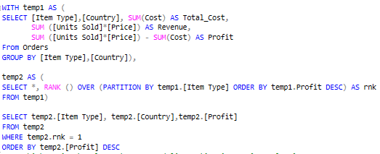
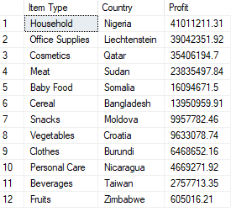
For each item type, what is the country which gains the max profit?
Queries script:
Result:
With the results shown above, Household item purchased by Nigeria country had noticeably profit (about 41 million) , while profit from Office Supplies was highest in Liechtenstein, at 39 million. Profit of Fruits reach 6 million in Zimbabwe , but it was far lower than profit achieved from Household and Office Supplies.

Slide 7
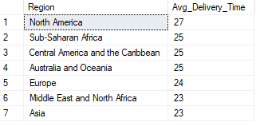

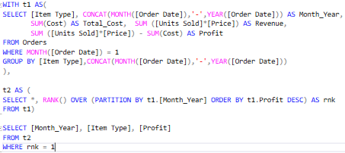
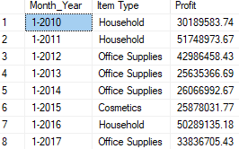
Which region has longest average delivery time in 2016? How long?
Queries script:
Result:
In 2016, North America had longest average delivery time with 27 days.
5
Which item type contributes most profit in Jan?
Queries script:
Result:

Slide 8

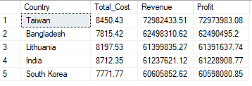
What is total profit of top 5 countries which are sorted by Online channel orders?
Queries script:
Result:
At Online channel, Taiwan had by far the highest profit with nearly 73 million.

Slide 9

Evaluate business situation. Illustrate your insights by chart. In your opinion, what does the company should improvise?

Slide 10
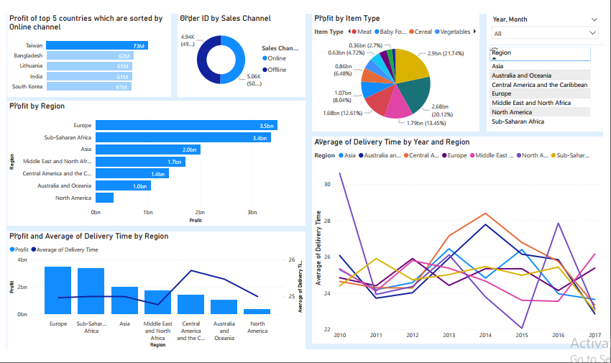
7.1
Evaluate business situation from dashboard (Method: Power BI)

Slide 11
7.1
Evaluate business situation from dashboard
From the chart above, we can see Household item had by far the highest profit with proportion at 21% of total profit, while the next most popular item was Office Supplies (20%). By contrast, the figure for Fruits, Beverage and Personal Care were below 3% with percentage of profits was at 0.29%, 1.69% and 2.69% respectively.
There was not too much difference of total orders purchased between 2 sales channel ( Online and Offline), but the online channel seems to have slight edge in term of proportion (50.61%). The proportion of purchasing by Online channel was highest in Taiwan at nearly 73 million.
In the last seven years, high profits have come from Europe and Sub – Saharan Africa, with 3.5 billion and 3.4 billion respectively. While this figure just reach at 0.3 billion in North America.
About delivery time feature, the average time need to delivery orders to each regions fluctuated from 23 to 30 days of the 7 – year period. In 2010, the figure in North America was highest with 30 days needed. But it was significant change in the trend of waste time, while the respective average of time dropped to 23 days in 2021 and just 22 days in 2015. In 2016, North America again had longest average delivery time with 27 days. Figure for the other 6 regions were fluctuated from 23 to 27 days.
Profit achieved from regions that take less time ( approximately 24 days) to delivery such as: Europe, Sub – Saharan Africa, Asia and Middle East and North Africa tend to be higher than those that take longer.

Slide 12
In your opinion, what does the company should improvise?
We can see that current problem is that average shipping time is being wasted too much in some regions. And in current situation , due to the impact of corona disease, the regulations to each region have made the shipping process more complicated. So company can survey and consider to choose different shipping suppliers in each region or using some shipping and tracking software to detect problems and solve them in time.
Another thing we can notice from current business is that proportion of profit obtained from Fruits, Beverage and Personal Care products were too low. We can easily realized how hard these things are to ship or preserve for a long period of time while in transit. So we need to consider delivery suppliers to make sure these products are not being damaged or destroy during the delivery process. Besides, company can run promotions to increase demand for those item ( give some free sample, loyal customer program, flash sale, offer vouchers and coupon after every purchase,,…)

Slide 13
In your opinion, what does the company should improvise?
With the development of information technical and digital platforms, we can expect online sales channel to grow significantly in the near future. So, company need to continue to improve dramatically online channel and provide variety of service to increase user experience:
Improve interface, speed, visuals and optimize in both website and mobile app flatform. With a online channel, we are not only able to attract new customers, but also improve the relationship with existing ones. It’s more convenient , faster and easier than go to directly to store.
Connect and collaborate with third party (shipping partner, online payment platform,…) provides discounts, free shipping, and free return…for products.
Personalizing customer’s experience by provide some recommendations that customer would be interested based on purchase history and searching history.
Promote products with online advertisement like Youtube, Facebook, … will drive brand awareness and link directly to our website.

Slide 14
REFERENCE
More detail of assignments can be found by following the link below:
Queries by MSSQL:
Dashboard by Power BI : or access this link

